Slide 1
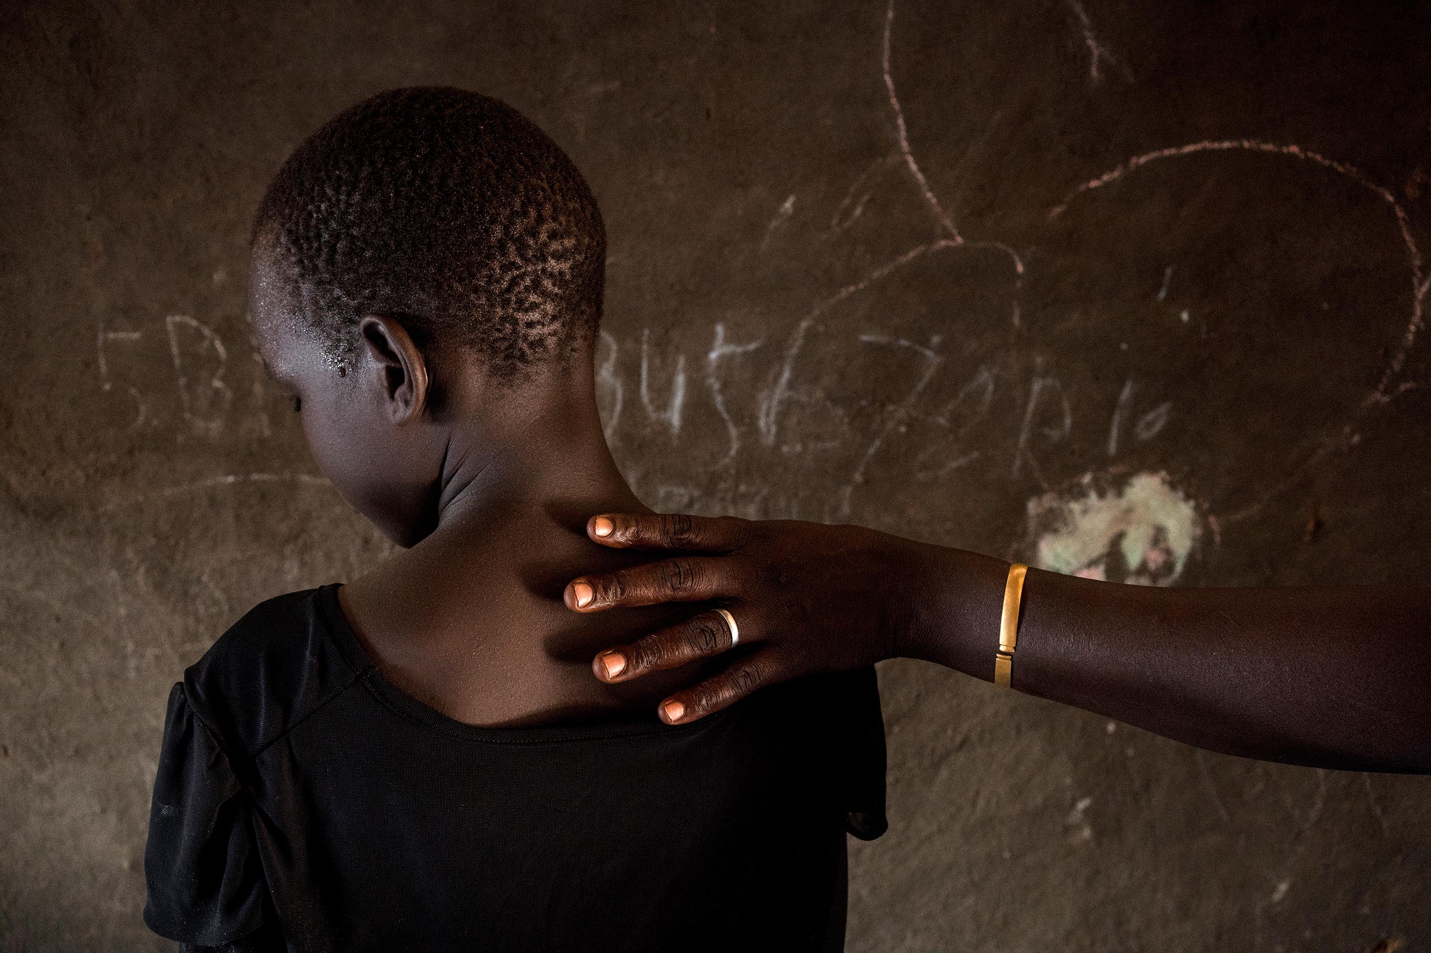


Guidelines for Media Reporting on Gender-Based Violence

Slide 2
GBV Sub cluster
One of the Areas of Responsibilities AoR under Protection cluster - global and country level humanitarian Architecture
Lead coordinating mechanism for all GBV related humanitarian Action
Promotes and coordinates inter Agency and multisector partners for prevention and response to GBV
Led by UNFPA and Co-lead by IRC since July 2017
About 200 GBV partners, only 15% with concrete programs
Technical Reference Groups
Health, PSS & Case management, Caring for Child survivors, Rule of Law, Prevention of GBV, Alternative Fuel

Slide 3

Functions of the GBV SC
1. support service delivery
  Service mapping, SOPs, Referral pathways, IEC materials etc
2. Promote strategic direction of GBV programming
  Needs assessment to inform programming; on going data collection, Developing an information system for coordination Making appeals for GBV funding
3. Advocacy including working with media
4. Support GBV primary prevention and risk mitigation including GBV mainstreaming
5. Conduct Capacity building to GBV partners, other clusters, media etc
6. Monitoring and evaluation of GBV programing in country

Slide 4
Basic Concepts of GBV
GBV is an umbrella term for any harmful act that is perpetrated against a person’s will and is based on socially ascribed (i.e. gender) differences between males and females.
It includes acts that inflict physical, mental or sexual harm or suffering, threats of such acts, coercion and other deprivations of liberty
Gender based violence can be categorized as:
  Physical violence
  Sexual violence
  Psychological/ emotional violence
  Harmful traditional practices and
  Socio-economic Violence

Slide 5
Basic Concepts of GBV

Slide 6
Basic Concepts of GBV
Health consequences
a) Fatal – Death and suicide
b) Non-fatal - STI including HIV/AIDS, Unwanted / early pregnancy, Serious injuries – disability, Fistula etc.
Emotional consequences
Mental health problems
Suicidal thoughts and behaviour
Socio-economic consequences
Rejection from family
Shame, Insecurity, self-hate, self-blame
Depression, Anxiety, Fear and anger
Family breakdown
Social rejection and isolation
Social stigma
Losses in women's earning potential
Etc
Etc

Slide 7
Survivors’ Best Interests
All efforts to document GBV for the purposes of media reporting must first prioritize survivors’ safety and best interests.
Survivor’s best interest must take precedence over other objectives, including drawing attention to particularly grave GBV violations, such as mass rape.
When media reporting fails to take into account basic ethical and safety principles, it can put GBV survivors, their families and those who are helping them at risk.
l

Slide 8
Timing matters - Access to lifesaving response services
Following being raped, a survivor requires lifesaving healthcare and other services for a period of time.
If a survivor feels like s/he will be identified or punished in some way because of social stigma and other factors as a consequence of being raped, s/he may not come forward to access life-saving help
Media and other non-treatment related interviews can add to his/her distress and discomfort about coming forward to seek help. Therefore, such interviews are not the first priority in at least one month post incidence

Slide 9
Avoid judgmental language
Writing about a survivor’s history, her/his sexual practices or sexual orientation, what she/he was wearing, where she/he was, what she/he was doing, or what time of day the abuse occurred is victim blaming.
GBV should not be presented as “normal” or part of the culture of the crisis-affected context.
Survivor and perpetrator ethnicities should not be reported.
Avoid using the term “alleged” rape or sexual assault or referring to a survivor as an “accuser” - could reinforce disbelief that a crime actually occurred and has the potential to reinforce negative stereotypes.

Slide 10
Never report details that could put survivors at further risk
Names, photographs, or other identifying information of survivors, their family members, or even at times those actors who are providing assistance (depending on the context), should not be used.
Any breaches to this best practice can put survivors’ lives at risk.
Since the name of the survivor or any other identifying information must be changed in the story, there is no need to write names down.

Slide 11
Use of images, footage and photographs
Photos should not include any identifiable information.
Any use of images should present the subject in a way that upholds dignity.
Where possible, images should be used to illustrate a general situation, rather than a specific incident of GBV. It is not recommended to take pictures of survivors.
Photos of child survivors should never be used.

Slide 12
Impartiality
Not your job to judge or discriminate.
Do not mention details that can be interpreted as blame on the survivor.
Do not mention clothes worn at the time of an attack or other aspects of a survivor/victim’s appearance - implies judgment of them.
Particularly true when writing features: some journalists may attempt to add detail and ‘colour،’ which can unintentionally shift the focus of blame away from the perpetrator.

Slide 13
Respecting Privacy
Principled، ethical journalism means respecting the privacy of both gender-based violence survivors and their families.
Be wary of ‘jigsaw identification’ when granting anonymity. This happens where audiences can piece together details - such as location، age، clothing or family members - even though journalists don’t name the survivor or show their face.

Slide 14

WHO Ethical & Safety Recommendation:
Benefits of documenting Sexual Violence must be greater than the risks – Do no Harm
Methodologies should be grounded in best practices.
Ensure availability of minimum care & support for survivors
Safety & security of survivors, respondents, participants and staff
Protect the confidentiality of survivors, respondents, participants
Informed consent
Training and ongoing support for staff
Safeguards must be in place for children to be involved in information gathering

Slide 15
Survivor Centered approach
Survivor-centred approach: A survivor-centred approach creates a supportive environment in which the survivor’s rights and wishes are respected, their safety is ensured, and they are treated with dignity and respect. A survivor-centred approach is based on the following guiding principles

Slide 16
Guiding Principles of Working with a GBV Survivor
The guiding principles on GBV were established to ensure that key actors who are working to prevent and respond to GBV ensure no further harm comes to survivors or the community as they request for help.

Slide 17
Main guiding principles
RESPECT
CONFIDENTIALITY
SAFETY AND SECURITY
NON DISCRIMINATION

Slide 18
GBV guiding principles
Safety: Safety and security of survivor, family and those who assisted her must be the number one priority for all actors including journalists
Confidentiality: Not disclosing any information at any time to any party without the informed consent of the person concerned.
Respect: All actions taken will be guided by respect for the choices, wishes, rights, and dignity of the survivor.
Non discrimination: Survivors of violence should receive equal and fair treatment regardless of their age, race, religion, nationality

Slide 19
1. RESPECT:
Appreciating and valuing the person and his or her experiences, ideas, decisions and actions
HOW DO YOU SHOW RESPECT TO A PERSON (SURVIVOR)?

Slide 20
Respect cont…
You can respect the survivor by:
Conducting interviews in private settings
Conducting interviews and examinations by staff of the same sex as the survivor
Being a good listener
Maintaining a non-judgemental manner concerning the survivor and her or his behavior
Being patient

Slide 21
Respect cont…
If and when possible, not asking the survivor for more information if he or she is not ready to speak about the incident
Asking only relevant questions

Slide 22
Respect cont…
Not discussing the survivor’s previous sexual history
Avoiding asking the survivor to repeat her or his story in multiple interviews
Not laughing or showing any disrespect for the survivor and her or his culture, family or situation

Slide 23
Respect cont…
Think about a time when you were not respected.
How did you feel?

Slide 24
CONFIDENTIALITY
This means that information will be shared ONLY with others who need to know about the case in order to provide assistance and intervention, as requested and agreed to by the survivor.
ROLE PLAY Confidentiality

Slide 25
Confidentiality cont…
If confidentiality is breached it could bring grave consequences for the survivor, particularly if adequate protection is not in place.
It also may discourage other survivors from coming forward

Slide 26
Confidentiality cont…
If confidentiality is breached, there can be;
Threats to the survivor, the perpetrator and/or the GBV worker
Injury to the survivor, the perpetrator and/or the GBV worker
Death of the survivor, the perpetrator and/or the GBV worker

Slide 27
Breaching Confidentiality
The ONLY TIME confidentiality should be breached is when there is imminent risk to the survivor or the GBV worker e.g. threats of violence, death threats

Slide 28
Safety and security
At all times, you MUST make sure the survivor is safe. The safety of the survivor must remain paramount in your work

Slide 29
How can you make sure that the survivor is safe and secure?
Keep all information confidential
Relocate survivor if possible
Report all threats to relevant authorities

Slide 30
NON DISCRIMINATION
EVERYONE seeking GBV services should access the service if available

Slide 31
Conduct research before interviewing
This session has been covered
The interview process should begin with research
It is important to do background research on GBV in order to develop a news story. There is ample factual information readily available on gender-based violence on the internet – do the research before asking GBV experts to do it for you
GBV Experts can guide media to ensure that story presented in way so as to not increase the risk of further abuse or retribution against survivors, their families, or others who are helping them get care.

Slide 32
Local support services and organizations who are addressing GBV in the context.
Include contact information of local support services so survivors/witnesses, their families and others who may have experienced or been affected by GBV to access the care they need.
Critical to obtain consent of service providers prior to printing or broadcasting information on services.

Slide 33
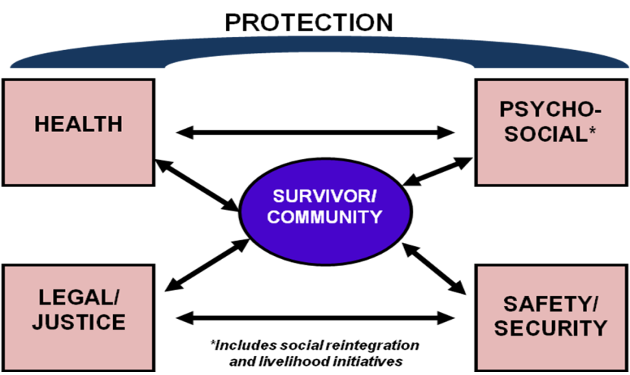
Multi Sectoral Services for GBV Survivors

Slide 34

. What are the take away messages while producing a GBV content?

Slide 35
Things to think about while producing
GBV content
Have you protected your sources/interviewees? Have you made sure that there will be no negative repercussions from your interaction with a GBV survivor?
Have you been specific in your terminology, and avoided vague or ambiguous euphemisms? For example, ‘The guard molested her’ has a different meaning from ‘the guard raped her.’ (This is because terms like ‘molest,’ and ‘sexual activity’ are vague, while rape is a specific crime that tells us what happened).
Have you avoided prejudicial descriptions of the victim? For example, ‘She was walking alone at the time of the attack’ (this description is not relevant, and could imply judgment of the person who has suffered from an attack).
  A woman may not report a GBV incident for fear of reprisals from her attacker, because she was disorientated following her trauma, or because of inadequate legal systems. Lack of immediate reporting does not imply she has made up the incident).

Slide 36
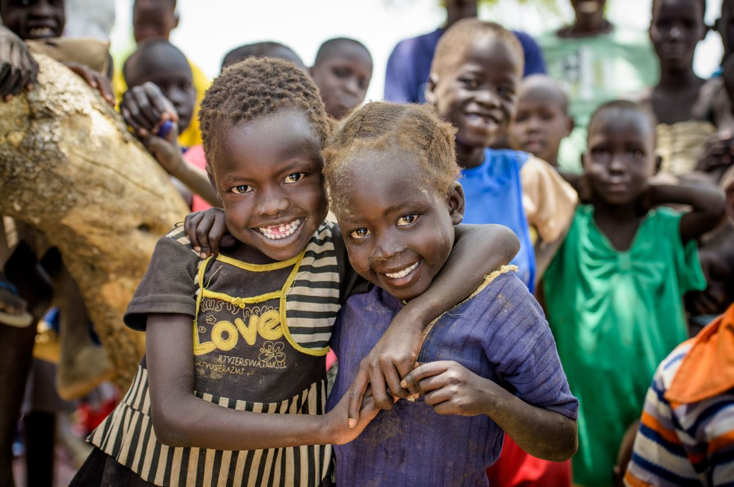
Thank You!

